Slide 2
R basics

Slide 3
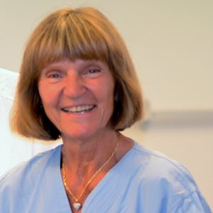
MetaTaxonomic Analysis
This part has been shortened this year
Statistics is too complex!
I have to leave early ☹
Moms’ birthday!

Slide 4
Important R points
Read the exercise document!
The numbers in the exercise fits the numbers in the ”DADA2.R” script!
Installing packages:
install.packages(”PACKAGE”)
install.packages(”BiocManager”)
Packages must be read with library() before you can use them!
library(”PACKAGE”)
Paths are just the adress of files. We use projects to keep paths simple!

Slide 5
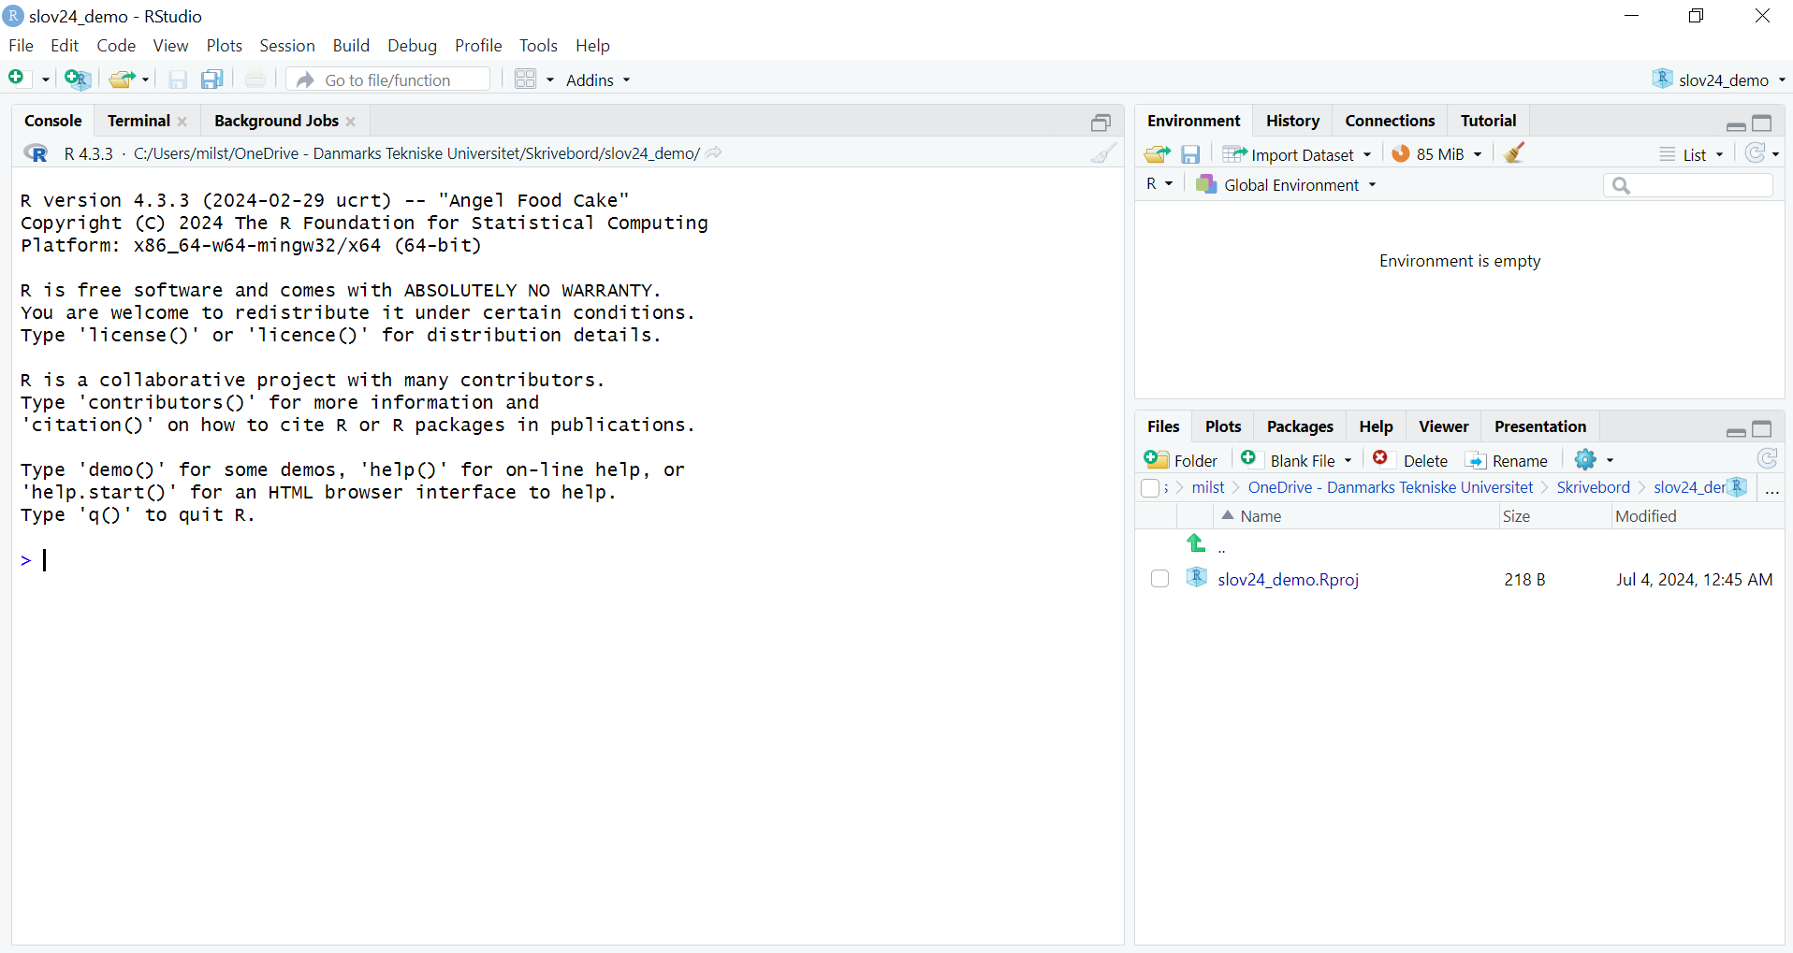

Slide 6
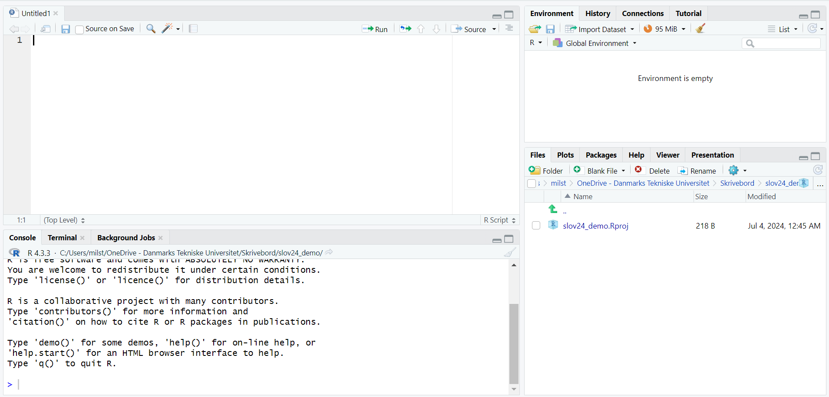
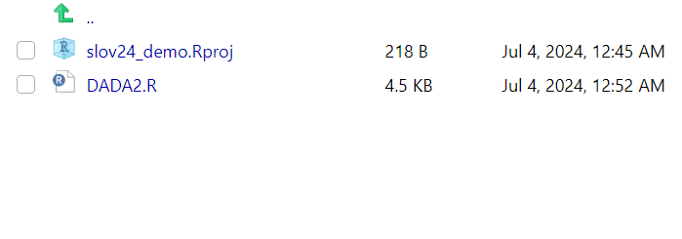
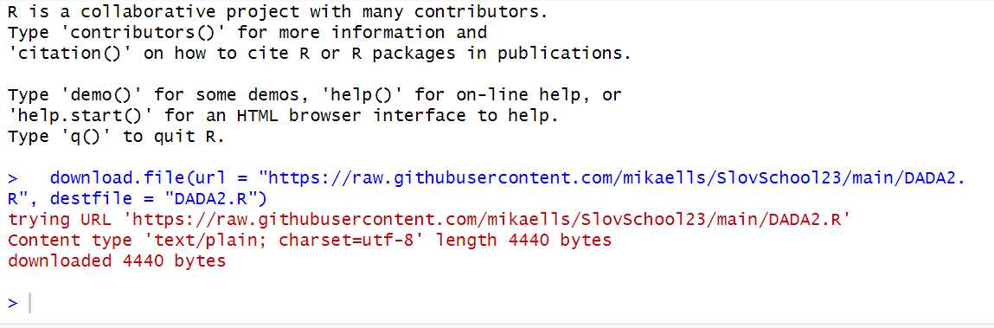

Slide 7
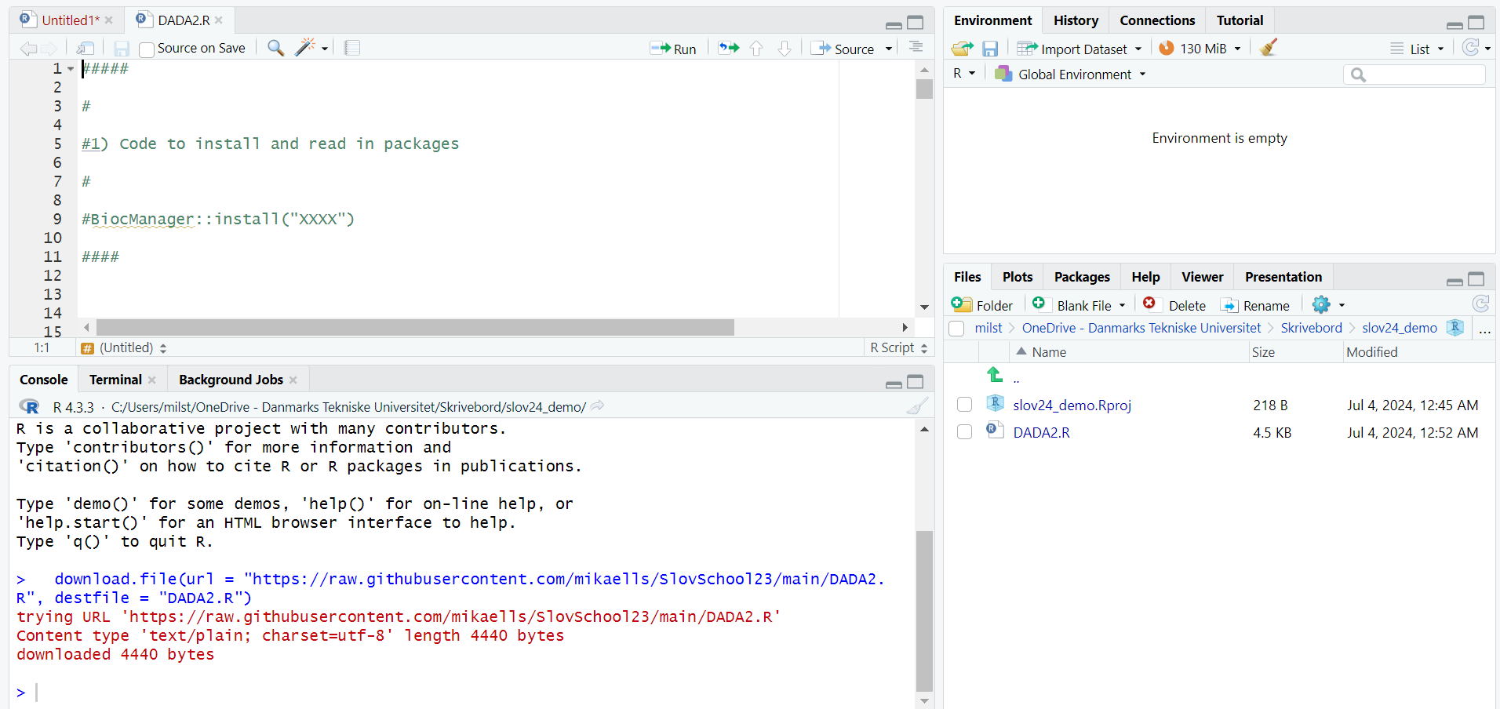

Slide 8
Skipped!

Slide 9
Variables
Data structures
Functions
Packages

Slide 10
Variables
A = 5
fraction = 5.48
theTeacher = ”Mikael”
studentNames = c(”Peter”, ”Hans”, ”Louise”)

Slide 11
Data structures
Vectors
CFUs = c(5, 12, 1, 48, 19, 12)
Types = c(”A”, ”A”, ”B”, ”B”,”C”,”C”)
Matrices
randomMat = matrix( c(1, 2, 3, 4, 5, 6), nrow=2, ncol=3)
cfuMat = matrix(matrix( CFUs, nrow=3, ncol=2)
Dataframes
aDataFrame = data.frame(Group=Types, Counts=CFUs)
Lists

Slide 12
Data structures
Accessing a value of a 1-dimensionel vector
CFUs = c(5, 12, 1, 48, 19, 12)
CFUs[4]
48
Accessing a value of a 2D data.frame
Types = c(”A”, ”A”, ”B”, ”B”,”C”,”C”)
CFUs = c(5, 12, 1, 48, 19, 12)
aDataFrame = data.frame(Group=Types, Counts=CFUs)
aDataFrame[3,2]
1

Slide 13
Functions
aFunction = function(a, b) {
c = a + b
return(c)
}
calculateMean = function(a, b, c) {
return(sum(a, b, c)/3)
}

Slide 14
Packages
install.packages(”vegan”)
install.packages("BiocManager")
BiocManager::install("dada2")
library(”vegan”)

Slide 15
Interactive R-session!

